Slide 1


Deep Learning Hackathon
Realtime Information Extraction with Deep Learning and A Priori Object Information on an Autonomous Racecar
Marvin Burges, Julien Fischer and Jonas Schenke
Elbflorace Driverless – TU Dresden

Slide 2
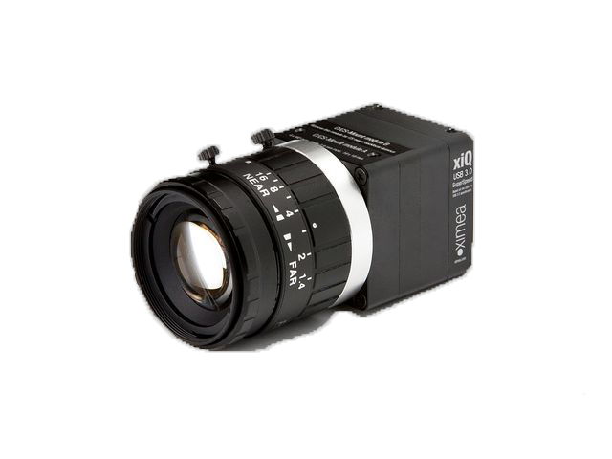
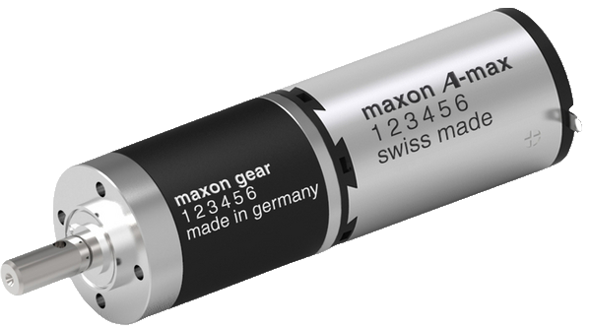
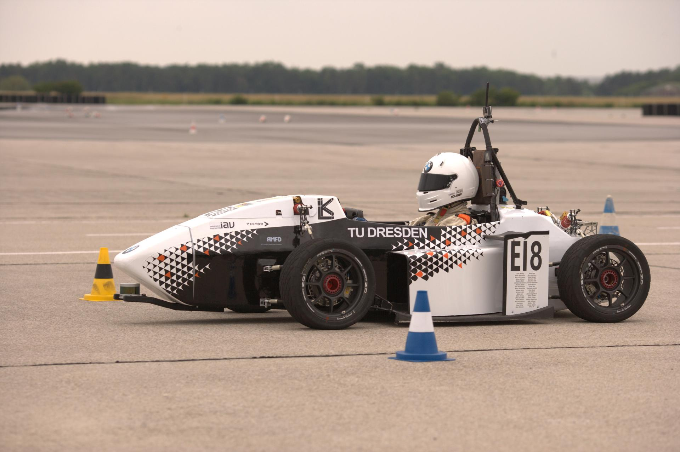
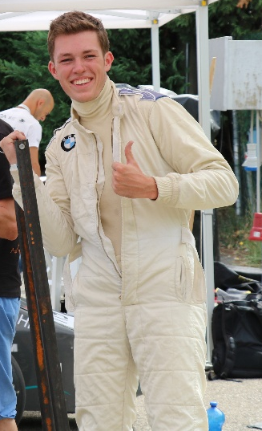
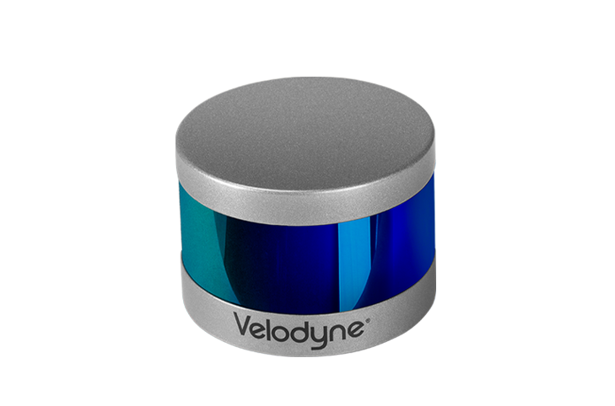
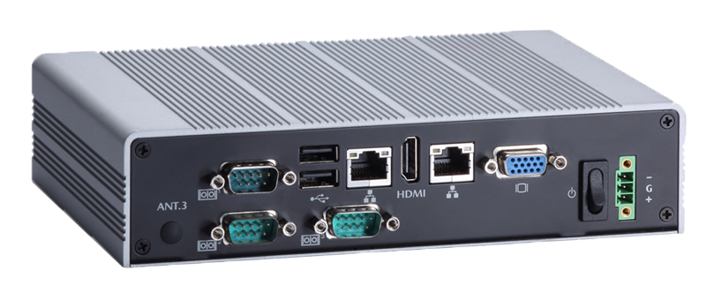

Concept Driverless
-
+
=

Slide 3



Trackdrive

Slide 4
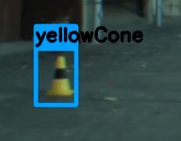
Idea
Detect Cone with color
Cut out bounding box
Regress 7 points
  To get the object outlines
Estimate Distance of the object
  Based on the outlines

Slide 5
What have we achieved?

Slide 6
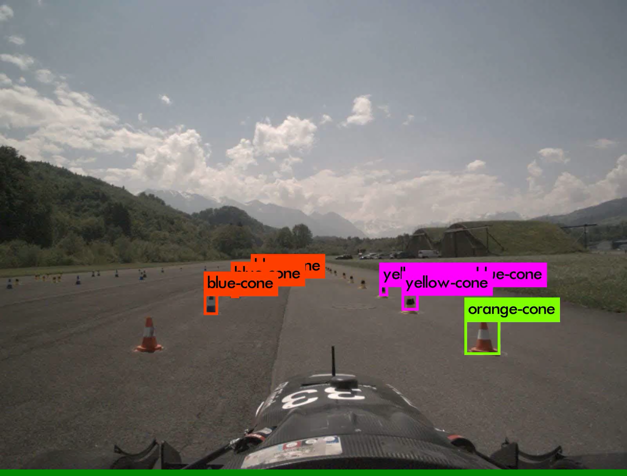
Object Detection

Slide 7
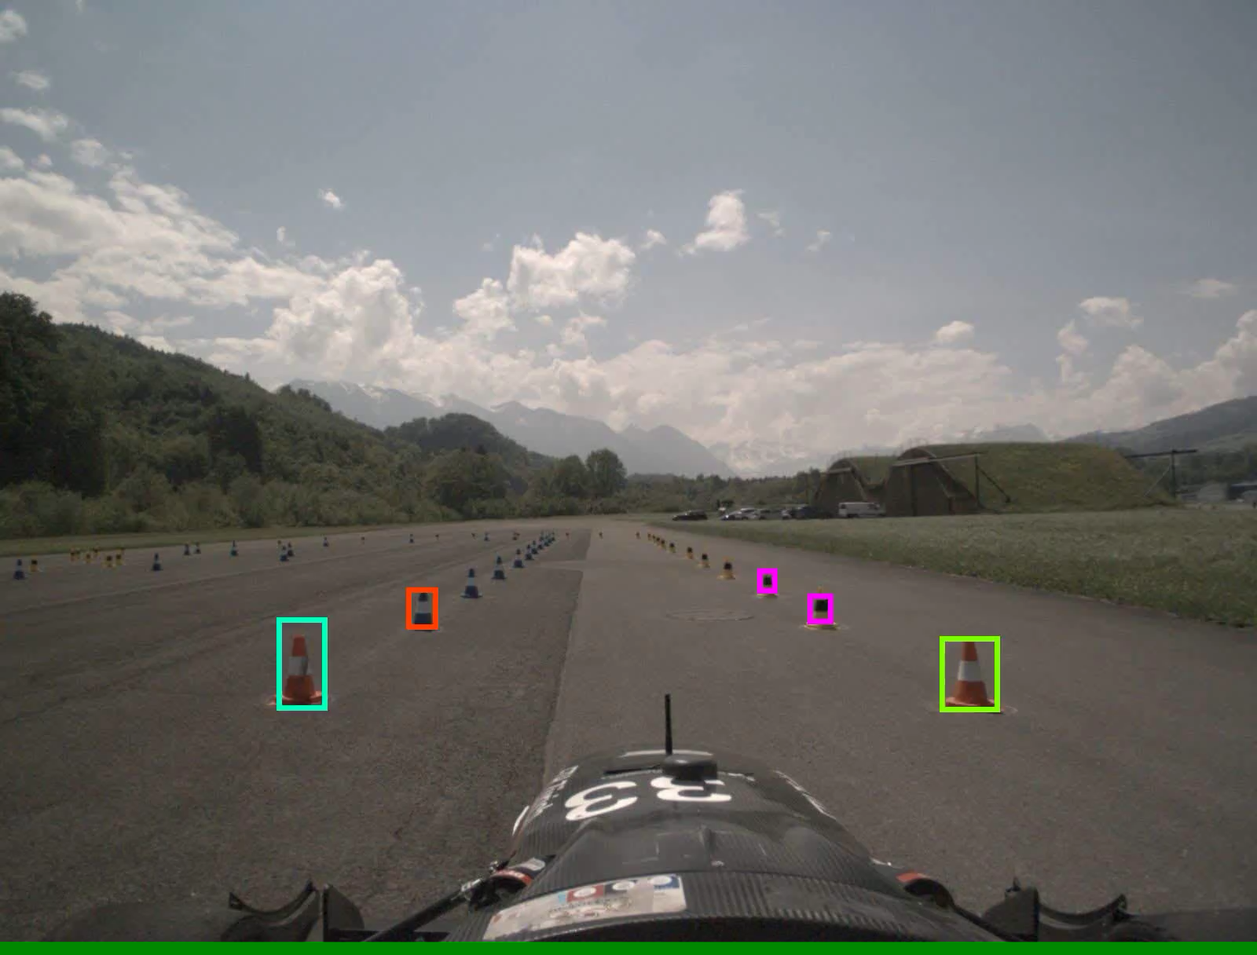
Object Detection

Slide 8
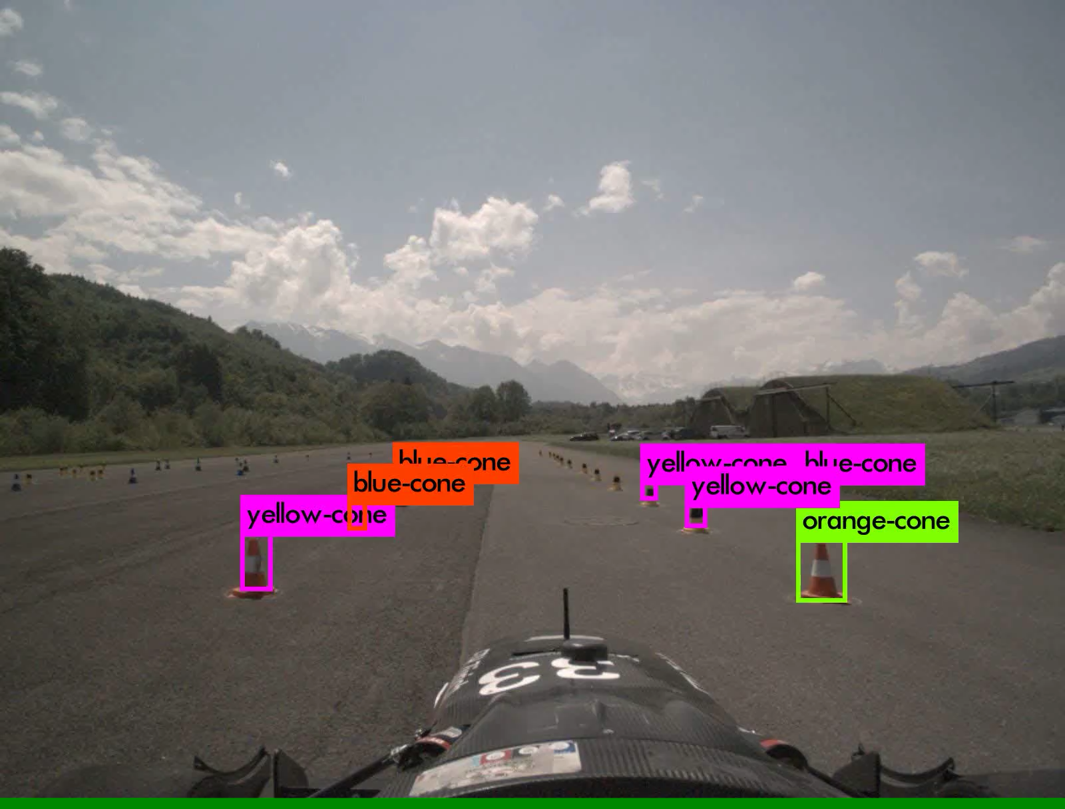
Object Detection

Slide 9
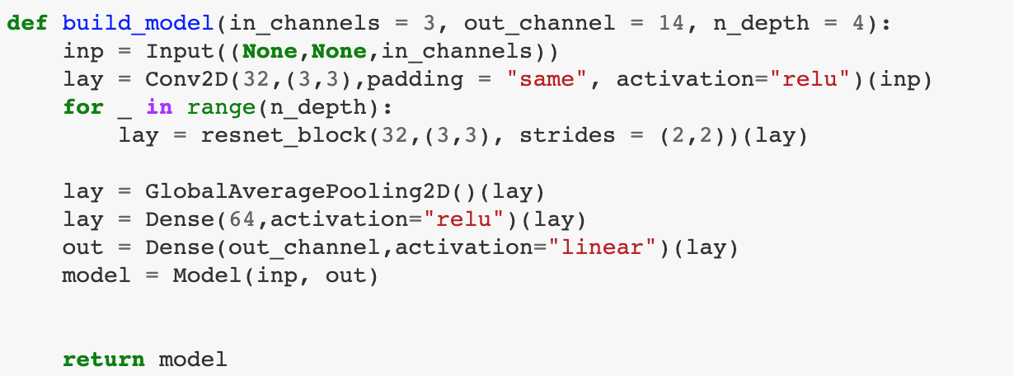
Point Regression

Slide 10
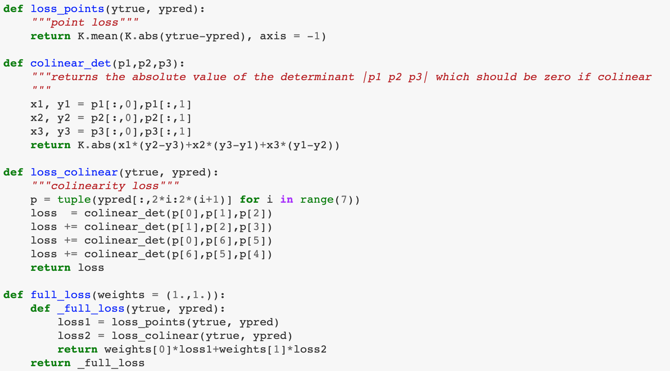
Point Regression
Two components:
1.) loss for coordinates (MAE)
2) Colineary loss for points on a straight line
e.g. |Det(p0,p1,p2)| ->0

Slide 11
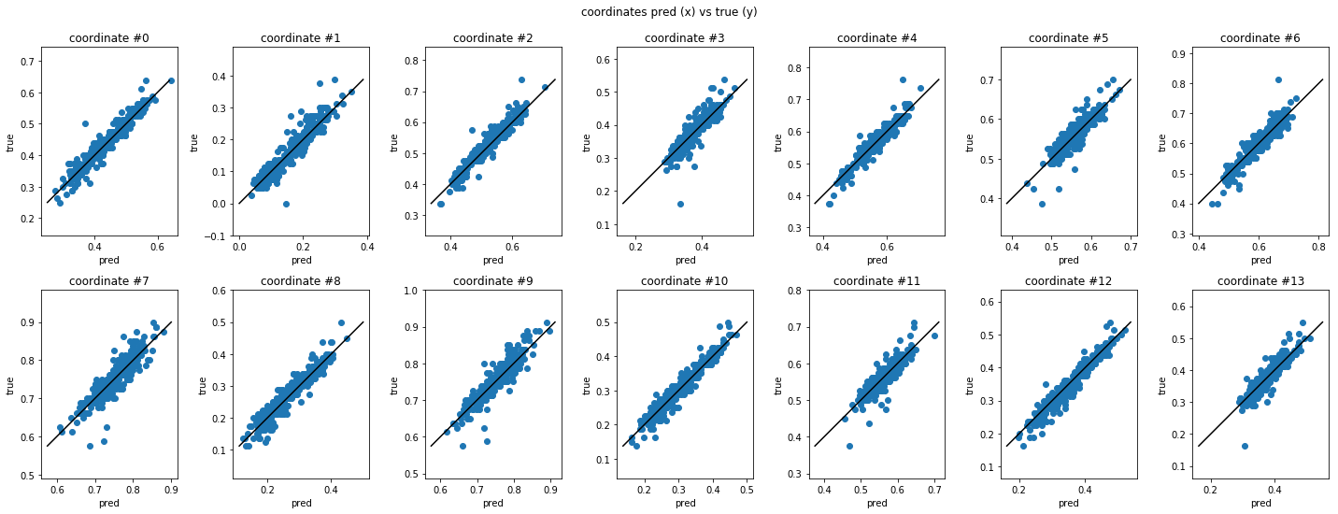
Point Regression

Slide 12
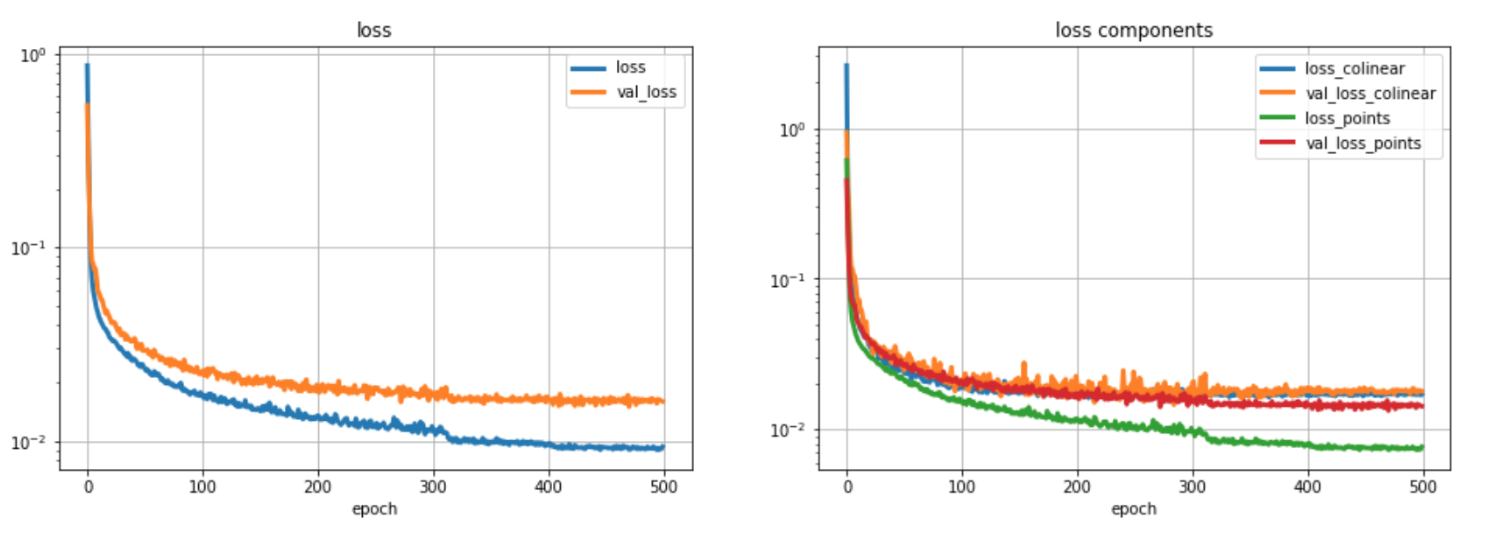
Point Regression

Slide 13
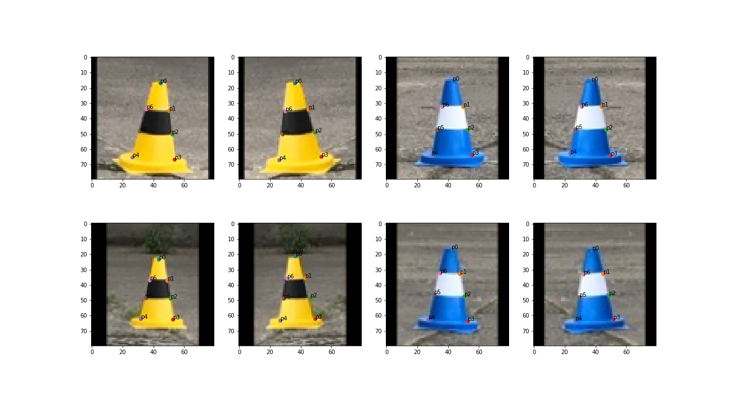
Point Regression

Slide 14
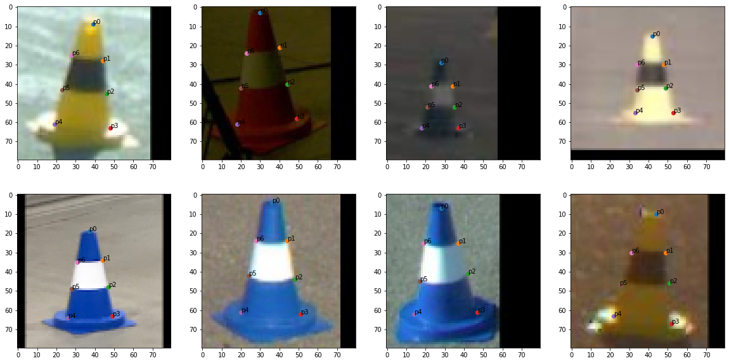
Point Regression

Slide 15
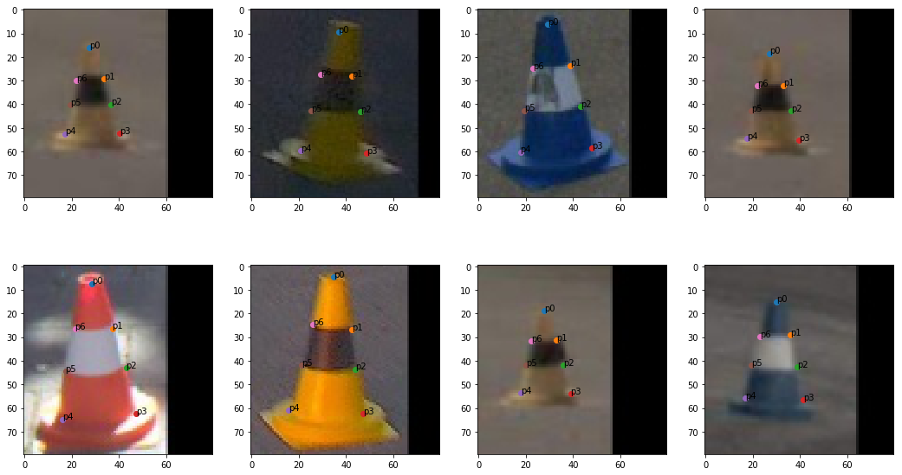
Point Regression

Slide 16
Distance Estimation
Pinhole Model
Machine Learning Approach

Slide 17
Thanks for your attention
Questions?

