Slide 1


Deep Learning Hackathon
Realtime Information Extraction with Deep Learning and A Priori Object Information on an Autonomous Racecar
Marvin Burges, Julien Fischer and Jonas Schenke
Elbflorace Driverless – TU Dresden

Slide 2
Background

Slide 3
What is Formula Student?
Founded in 1981 by the “Society of Automotive Engineers”
  At first only Combustion Cars
  Since 2010 also Electric Cars
  Since 2017 also Driverless Cars (Electric or Combustion)
At present more than 1200 teams compete
  Though only a fraction of those compete in the driverless section

Slide 4
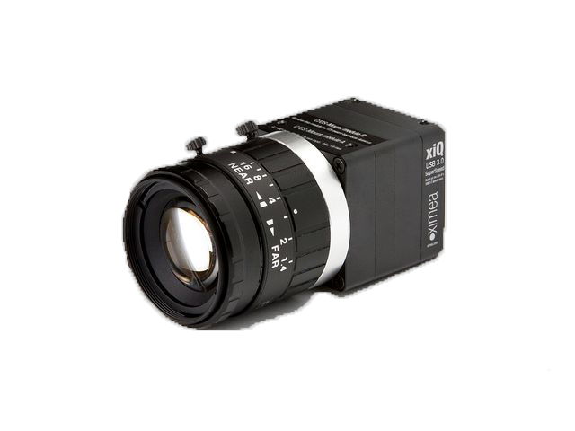
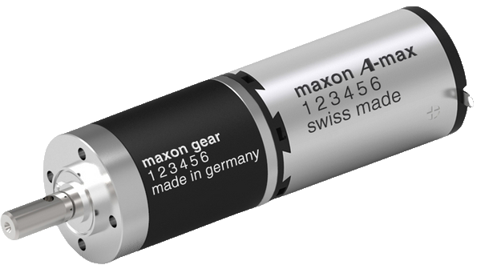
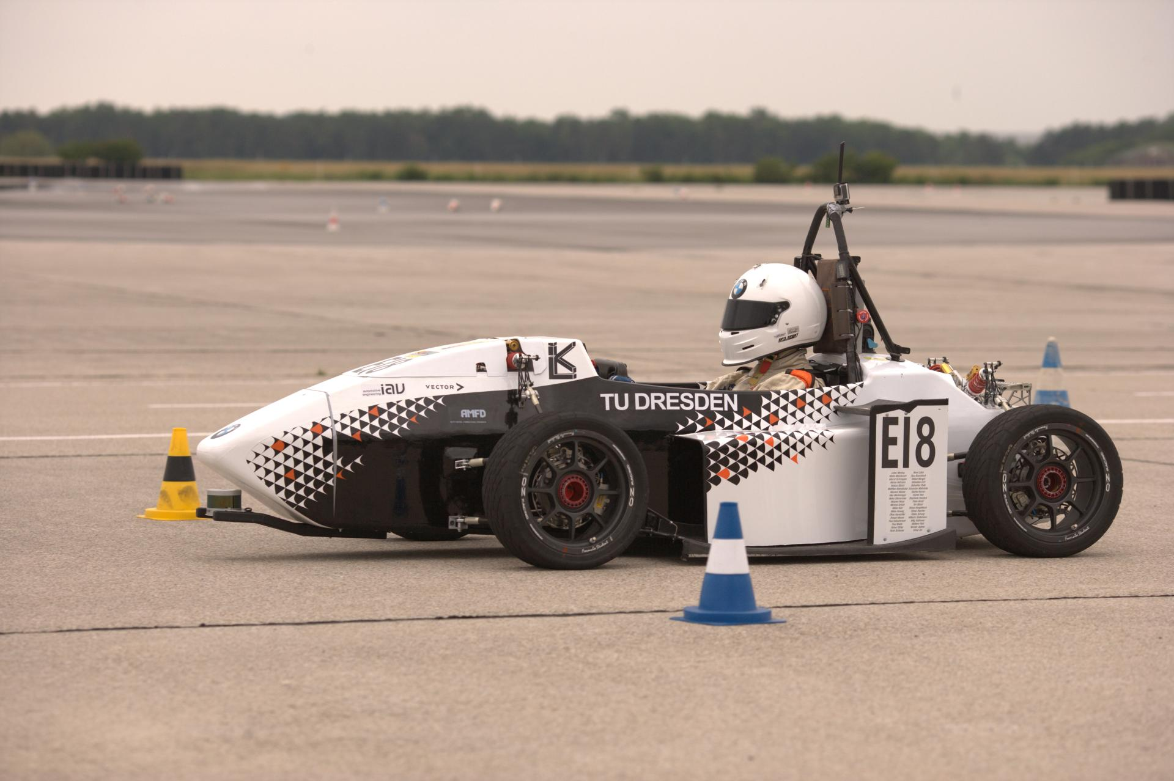
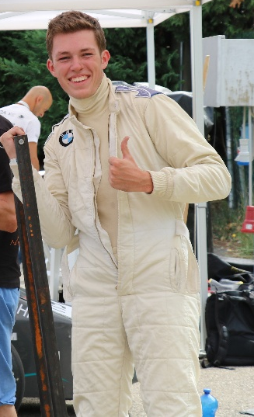
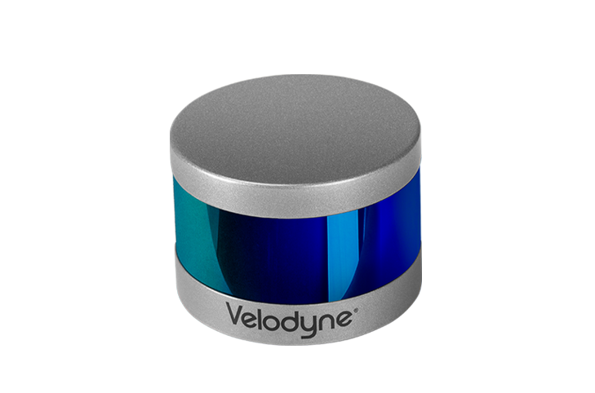
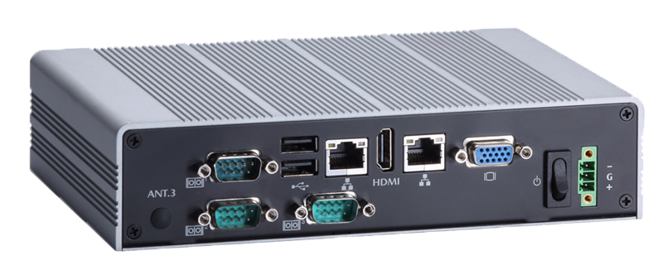

Concept Driverless
-
+
=

Slide 5
Driverless Diciplines

Slide 6



Trackdrive
10 Laps on a unknown track
Left side of the track is marked with blue cones
Right side of the track is marked with yellow cones
Target line is marked with two huge orange Cones

Slide 7
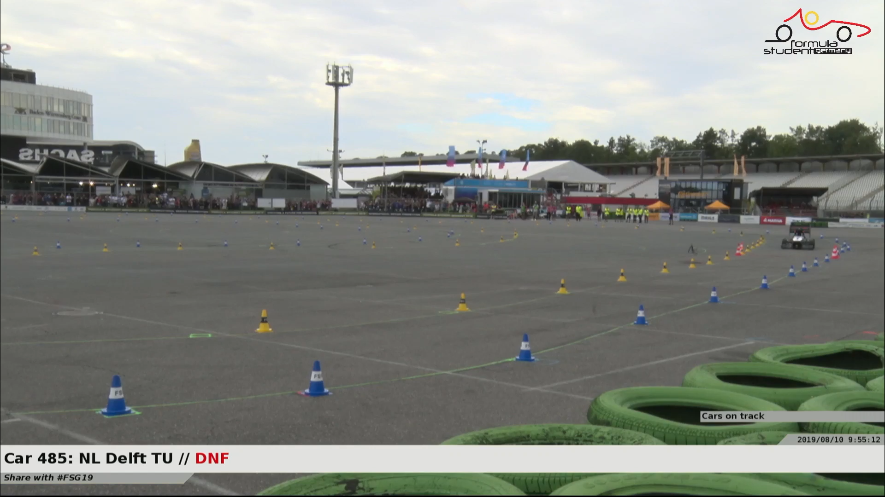
Video of this years winner
Copyright: Formula Student Germany / AMZ Racing

Slide 8
Motivation

Slide 9
Why do we need object detection?
Unknown track
  We need to detect our surroundings (obviously)
BUT: We already have a LiDAR for Cone Detection
  Why do we need object detection with a Camera?

Slide 10
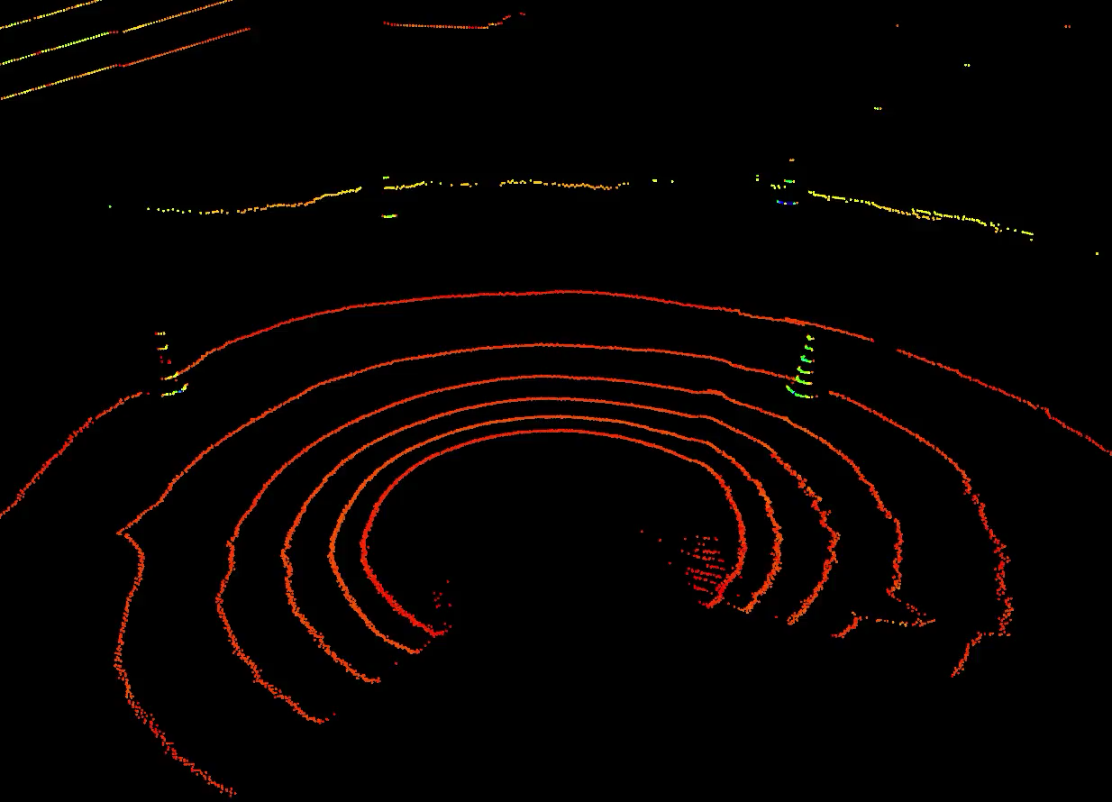

Slide 11
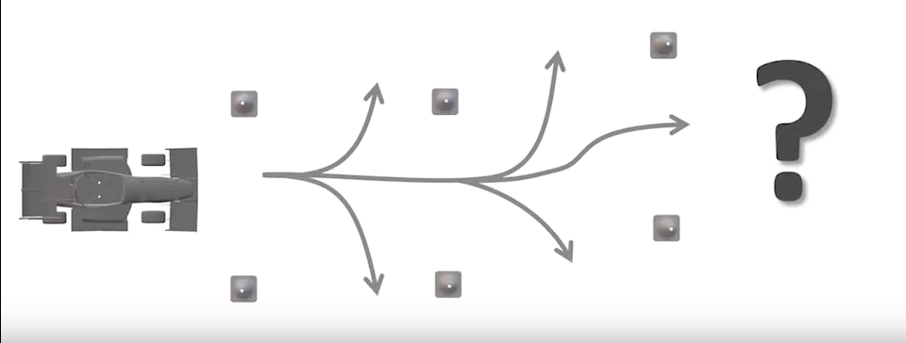

Slide 12
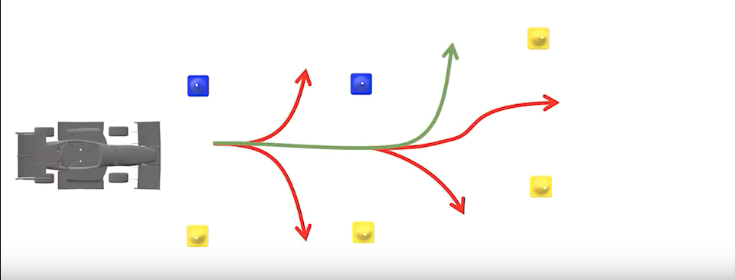

Slide 13
Implementation

Slide 14
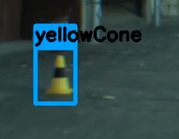
Idea
Detect Cone with color
Cut out bounding box
Regress 7 points
  To get the object outlines
Estimate Distance of the object
  Based on the outlines

Slide 15
Thanks for your attention
Questions?

