Slide 1
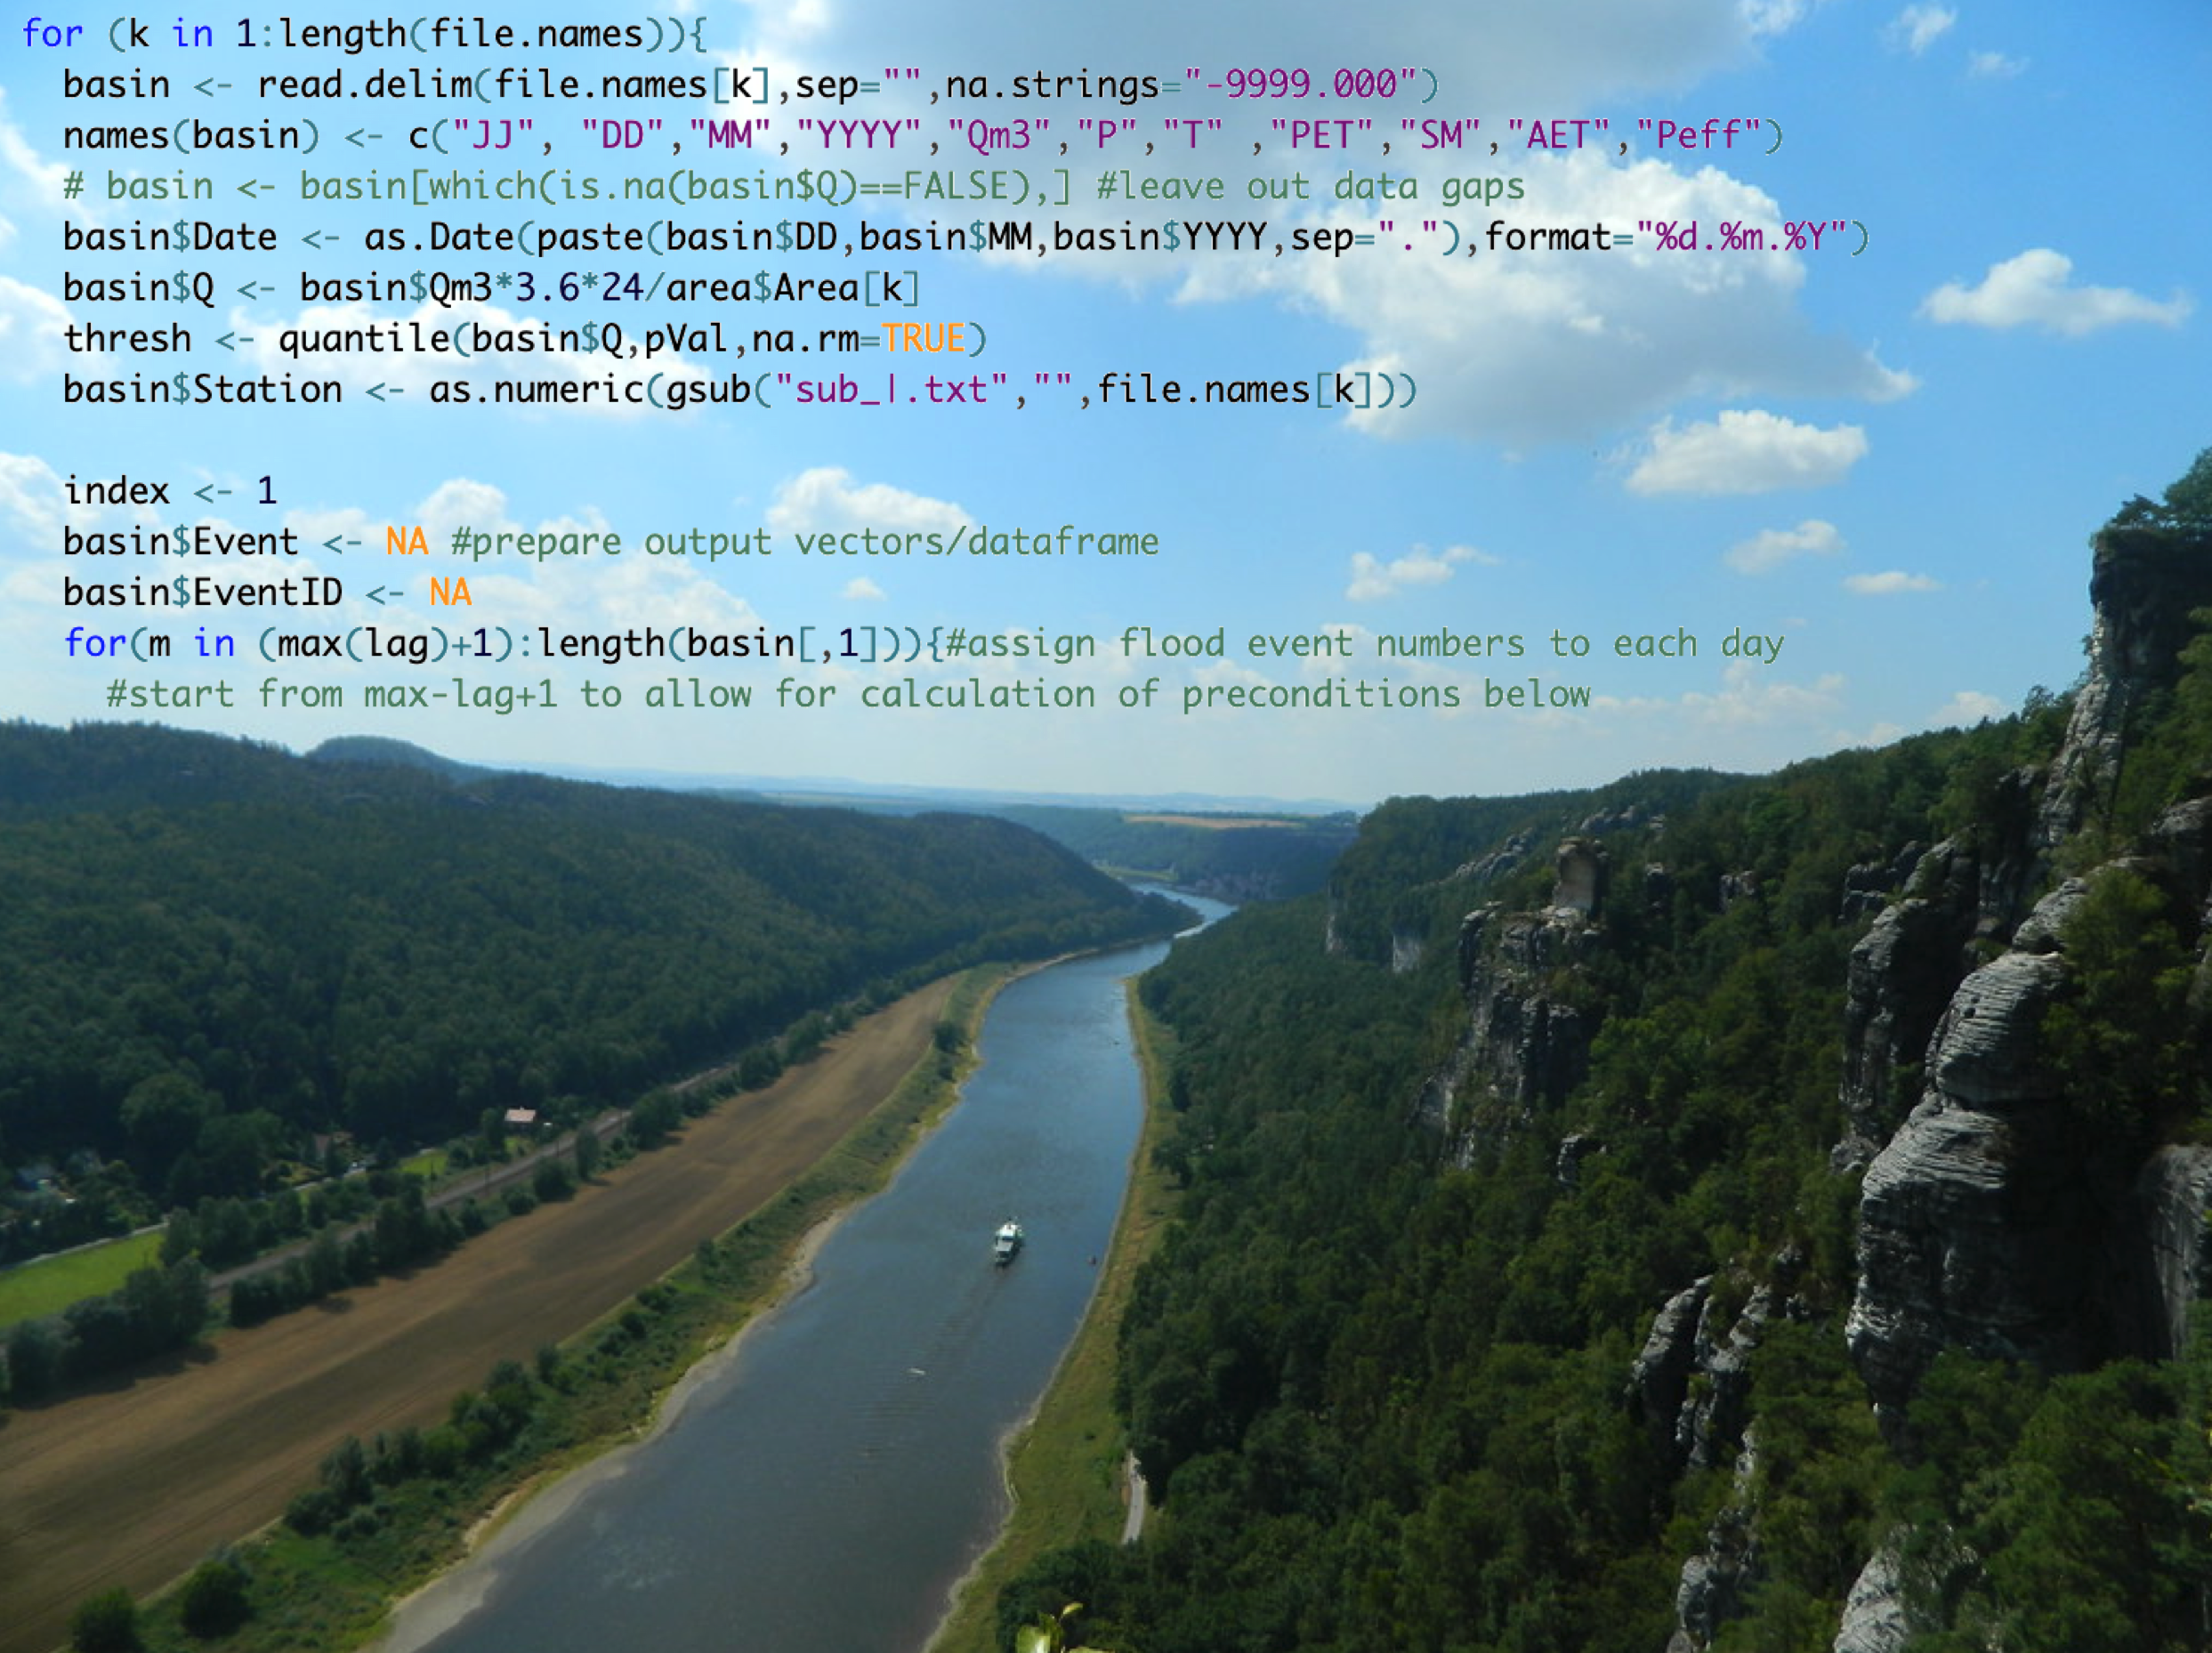

DeepHydro: Petrus 2.0
Lennart Schmidt, Elona Gusho, Walter de Back

Slide 2
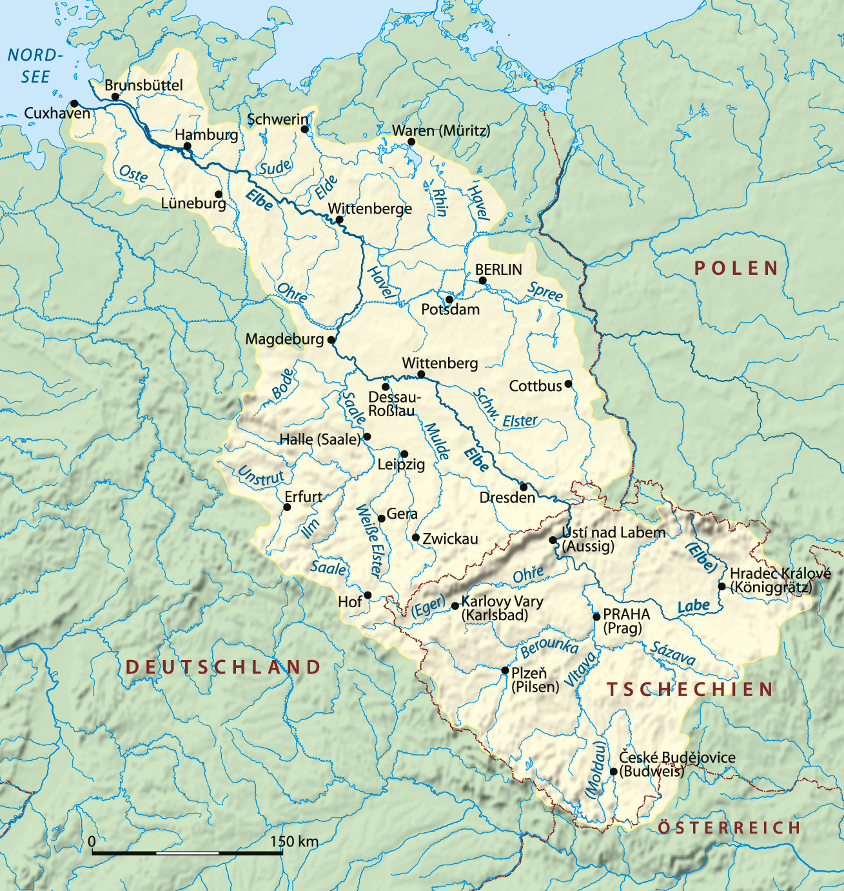
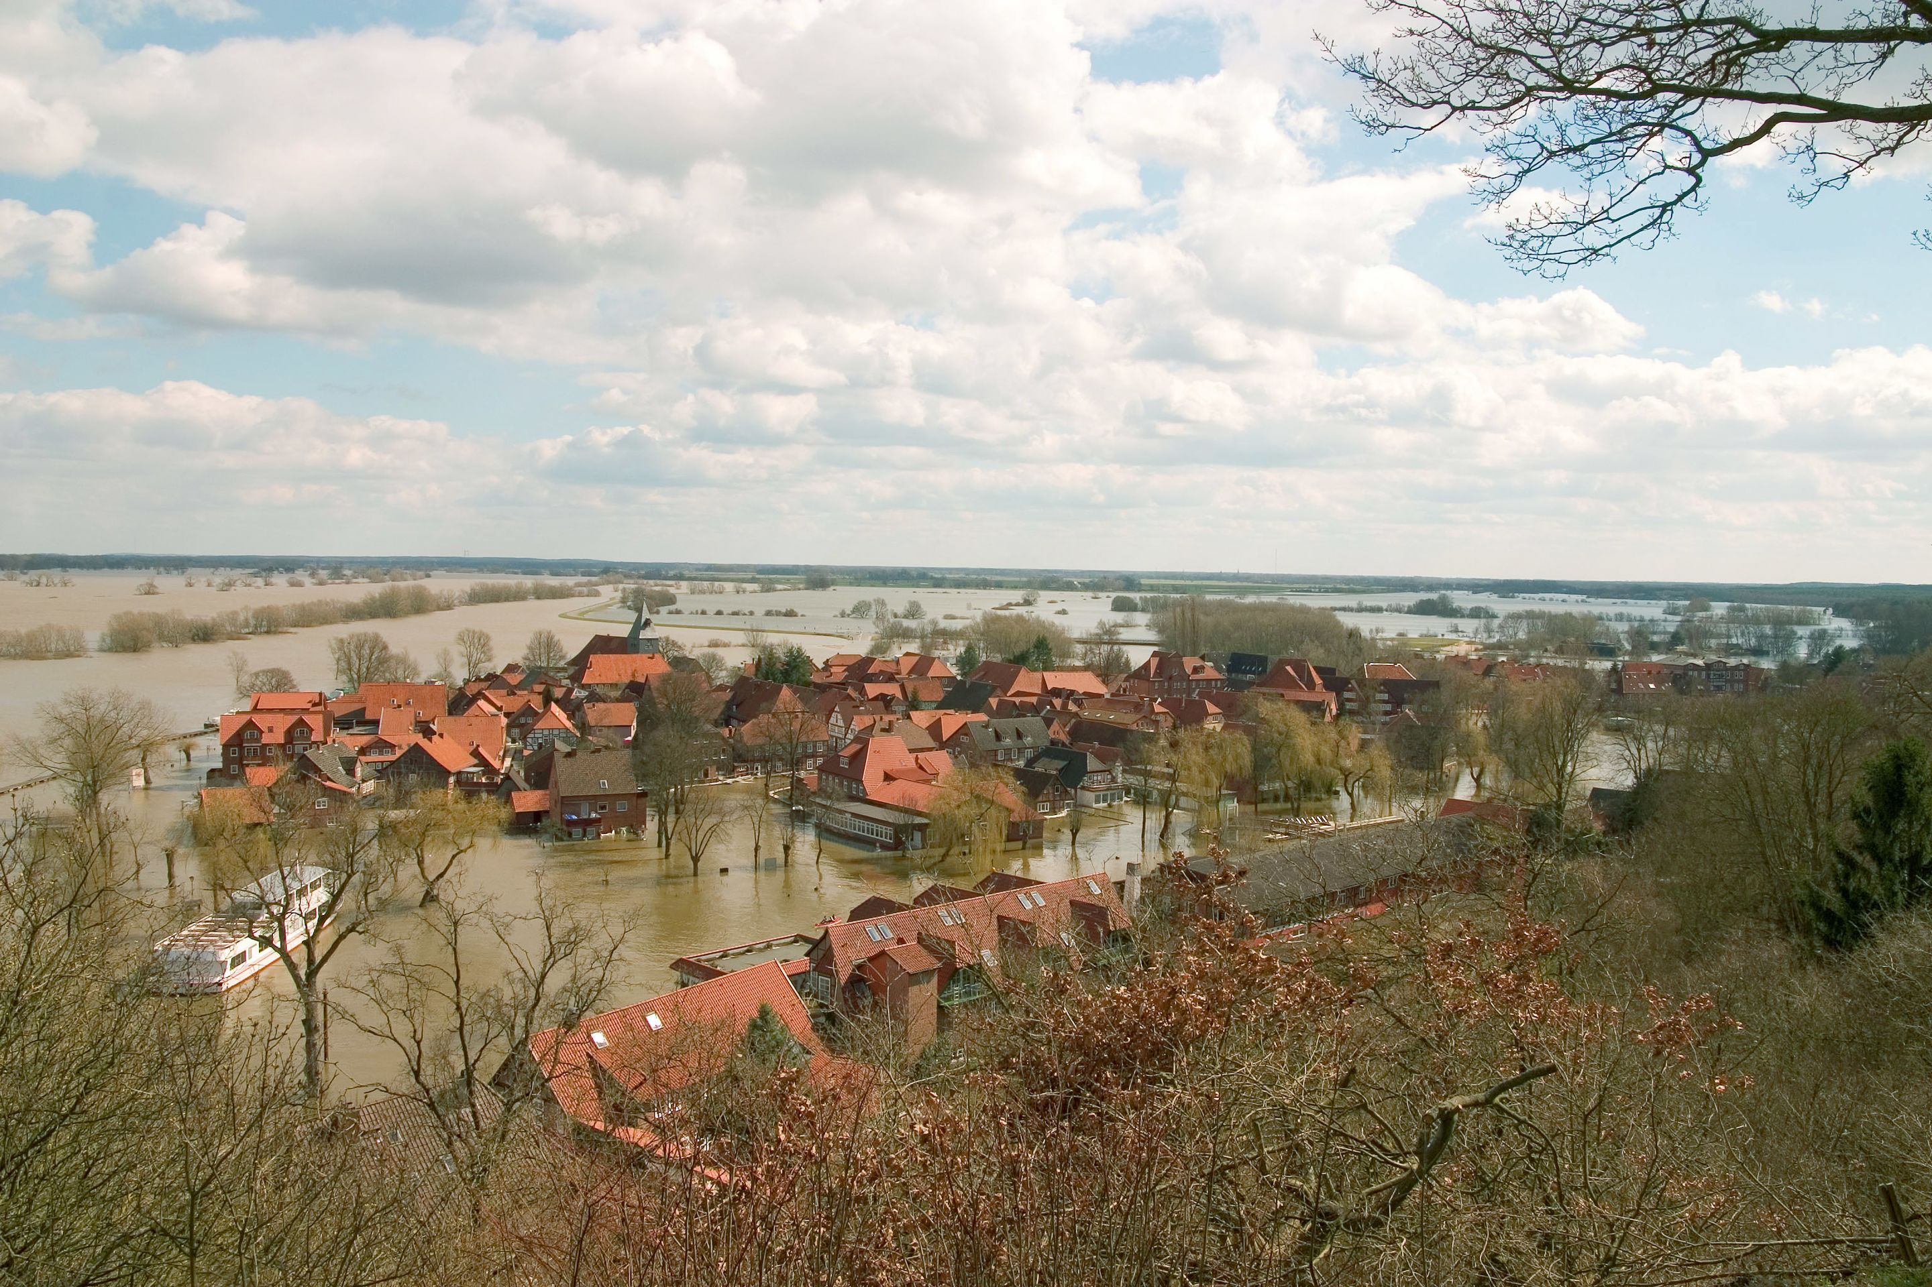
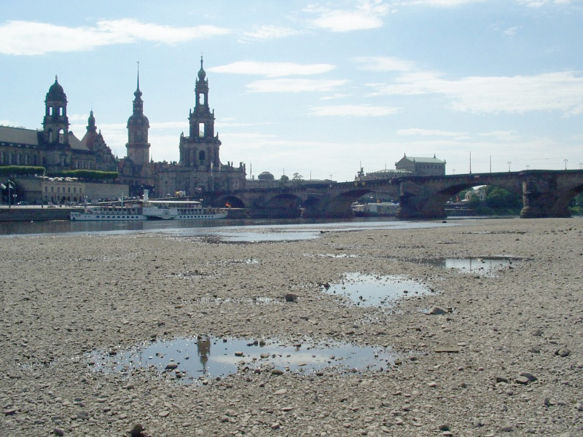
The Elbe catchment
Catchment: All precipitation drains into the river
4th largest river catchment of EU
https://commons.wikimedia.org/wiki/File:Elbe_Einzugsgebiet.png
Creative Commons
https://commons.wikimedia.org/wiki/File:Elbe-niedrig.jpg
Notes:
4th largest river in Europa
Deutschland: 357.578,17 km2 = 40% !!
4 neighboring countries

Slide 3
The Elbe catchment
Strong flood events in 2002, 2006, 2013
Low-flow period 2003, 2005
→ Need for accurate prediction of streamflow
https://commons.wikimedia.org/wiki/File:Elbe_Einzugsgebiet.png
Creative Commons
https://commons.wikimedia.org/wiki/File:Elbe-niedrig.jpg
Notes:
Major implication for society+ economy

Slide 4
The Elbe catchment
Catchment definition: All precipitation drains into the river
Length: 1245 km
Catchment size: 148.268 km²
Germany, Poland, Austria, Czech Rep.
Subject to strong flood events in 2002, 2006, 2013
Low-flow period 2003
→ Need for accurate prediction of streamflow
https://commons.wikimedia.org/wiki/File:Elbe_Einzugsgebiet.png
Creative Commons
Wiki: Niedrigwasser
Notes:
4th largest river in Europa
Deutschland: 357.578,17 km2 = 60% !!

Slide 5
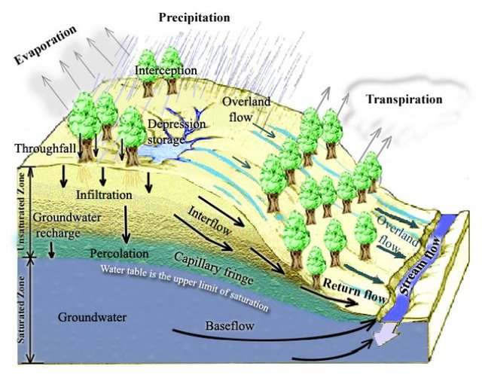
The hydrological system
Different hillslopes react differently!
Dol Raj Chalise: Evaluating Temporal and Spatial Scale Issues with Hydrologic Models in the Black Hills, South Dakota (2013)
Notes:
Spatial variability
Non-linearities

Slide 6
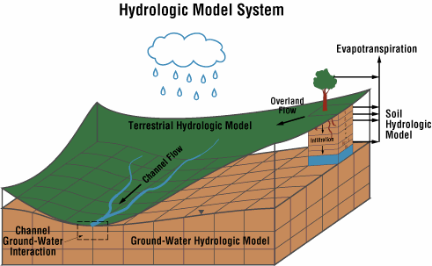
Traditional physical modeling
Grid volumes = mini storages
Information missing
Costly assumptions+parametrization
→ Deep Learning: Identify spatial units
http://www.essc.psu.edu/hms/hms/

Slide 7
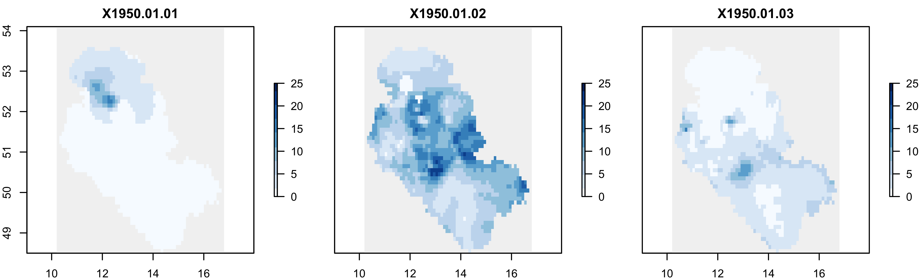
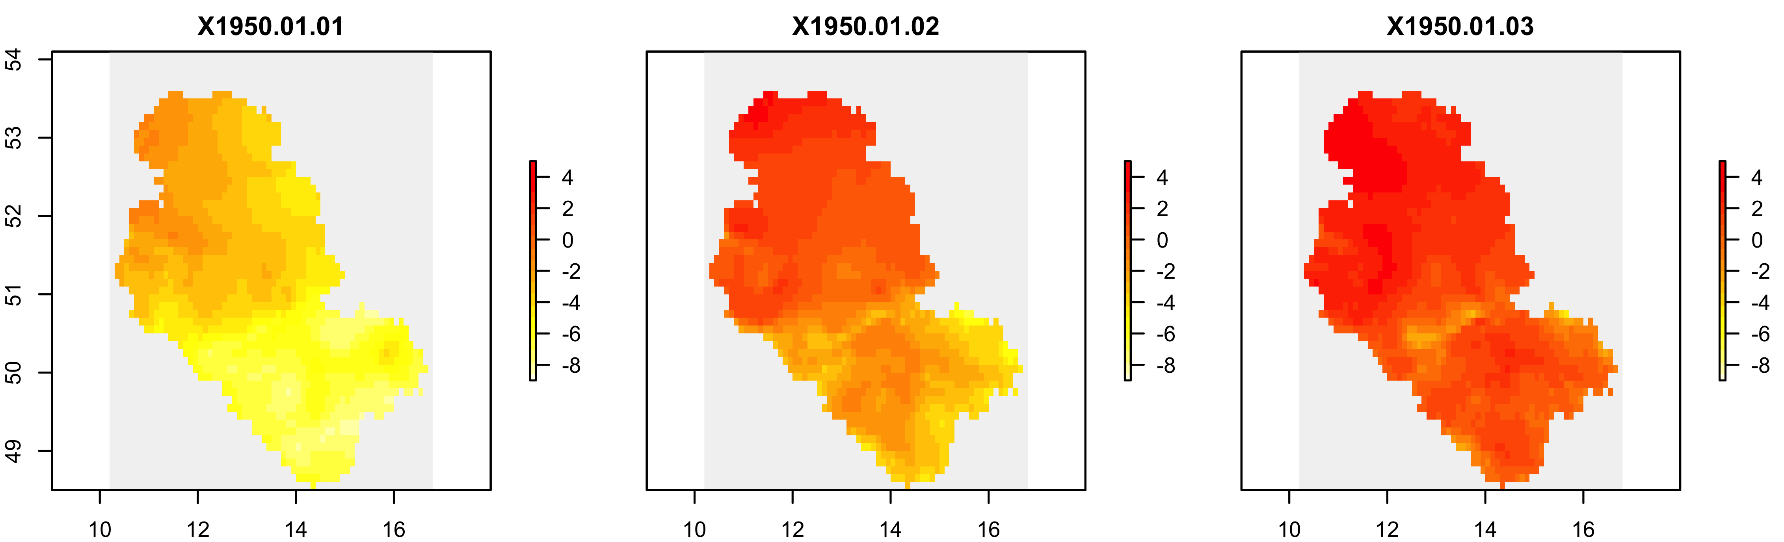
Data
Precipitation
Air temperature
CNN-LSTM
Target
Patterns
Time-lags
Input
Notes:
Basically a regression problem

Slide 8
Data
Precipitation
Daily mean values
1950 – 2016
Input:
Precipitation + Temperature
Dimensions: 56 x 66 x 24472
Target:
Dimensions: 1 x 24472
Air temperature
Input
Notes:
Coarse resolution compared to images but much data

Slide 9
Our goals
Evaluate Performance of Deep Learning
Evaluate gain in accuracy by including spatial information
Gain knowledge:
  Quantify the “Elbe`s memory“
  Saliency maps: Identify flood-inducing patterns in precipitation + temperature
Learn a lot
Networking

Slide 10
Thanks for your attention!

Slide 11
Why CNN-LSTM?
CNN:
Spatial heterogeneity in soil type, vegetation, geology, topography
Subregions respond differently to precipitation+temperature
Strong effect of spatial pattern of P+T on streamflow
LSTM:
Streamflow = baseflow + direct runoff
= long-term + short term component
Dol Raj Chalise: Evaluating Temporal and Spatial Scale Issues with Hydrologic Models in the Black Hills, South Dakota (2013)

Slide 12
Open questions
Resolution too coarse?
How to input both P+T: stacked rasters?
How to couple CNN+LSTM: Autoencoder first, hidden states as input into LSTM?
Good read on structures available?
Pretrained networks?
Layer-wise Relevance Propagation/activation maximization: Continuous target?

Slide 13
Research ideas
Short-term:
Gain in accuracy / Differences in saliency maps by including:
  Digital elevation model
  More streamflow gauges within the catchment
  Time of the year
Estimate uncertainty of predictions
Relevant time steps for prediction: What is the catchments‘ memory? Shifts summer/winter due to snow. Melt events in spring, PET different in summer…
Activation maximization/Layer-wise relevance propagation for identification of flood-inducing patterns → Analysis of results for flood years
Comparison to physical model: Long-term=baseflow/soil moisture, short-term=direct runoff. Any way to extract snow accumulation/melt to compare these against physical models estimates?
Nowcasting vs. Forecasting
Long-term:
Climate change forecasting: Non-stationarity
Comparison to standard LSTM: Lumped vs. Distributed
Possibility to fit a „global“ model by training on several large river catchments. Possible application of this: Prediction in ungauged basins (probably not possible)
…

Slide 14
Questions that will be asked:
Why not just use q upstream + P where necessary?
Yes, thats what they do but:
  Large catchment area between gauges -> climate station necessary, expensive
  Vision: P data from radar, T from citizen science/small local stations
Notes:
T is not very variable, so no fancy equipment is needed

